Slide 1




CRAFTING A GAME ENGINE: SURPRISINGLY SIMPLE!
FENRIR
ENGINE
By James Morgan

Slide 2




ABOUT ME
James Morgan
Senior Consultant @ Insight
CEO Pot Pirate
Passionate about all things game dev!
GITHUB

Slide 3


Slide 4
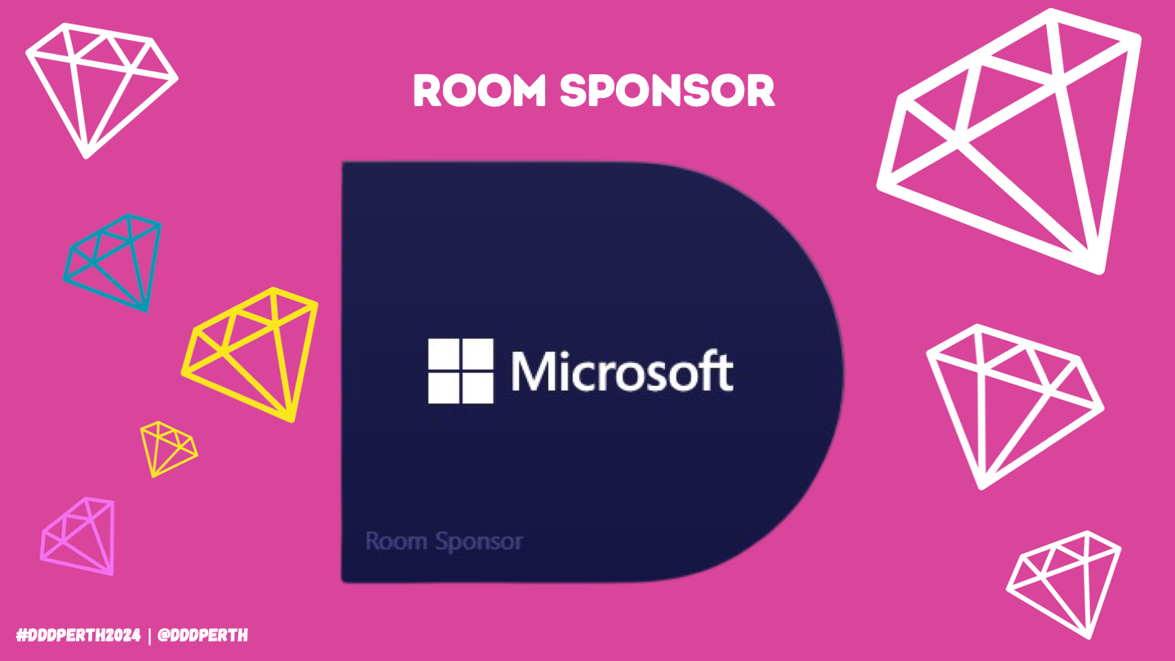

Slide 5
2
OUTLINE
WHAT IS AN ENGINE
MODERN ENGINES
ARCHITECTURE
SIMPILICITY
FACADE PATTERNS
PRACTICAL TIPS
COMMON PITFALLS
BEST PRACTICES
DEMO
Q&A

Slide 6
3
WHAT IS A GAME ENGINE

Slide 7

4
DEFINITION
A game engine, also known as a game framework, is a software-development environment designed for people to build video games

Slide 8

5
MY DEFINITION
A game engine, is a set of reusable libraries that can be glued together to build a game.

Slide 9





6
GAME ENGINE ROLE
Platform Abstraction
Reusable Libraries
Development Tools
Ease of Game Dev
Focus on Game

Slide 10
7
MODERN GAME ENGINES

Slide 11





8
ENGINES
Godot
Unity
Unreal
Open Source
Community Driven
Versatile
Lightweight
Closed Source
Widely Used
Versatile
Robust Toolset
Closed Source
Widely Used
AAA Quality
Robust Toolset
Frostbite
RAGE
Proprietary by DICE
High Performance
AAA Quality
Advanced Tooling
Proprietary by Rockstar
Realistic Worlds
AAA Quality
High Fidelity Tooling

Slide 12
9
HIGH LEVEL OVERVIEW

Slide 13
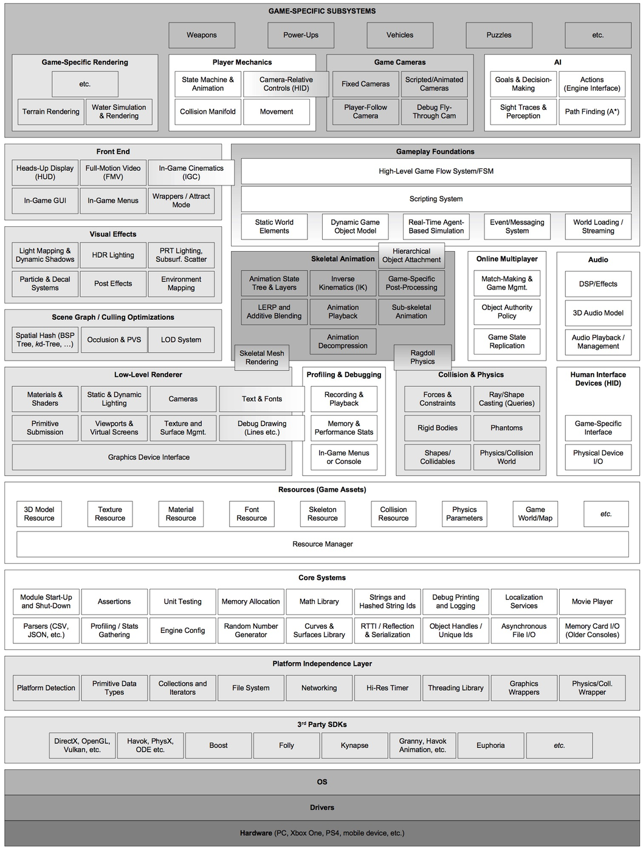
10
Game Engine Architecture
by Jason Gregory

Slide 14
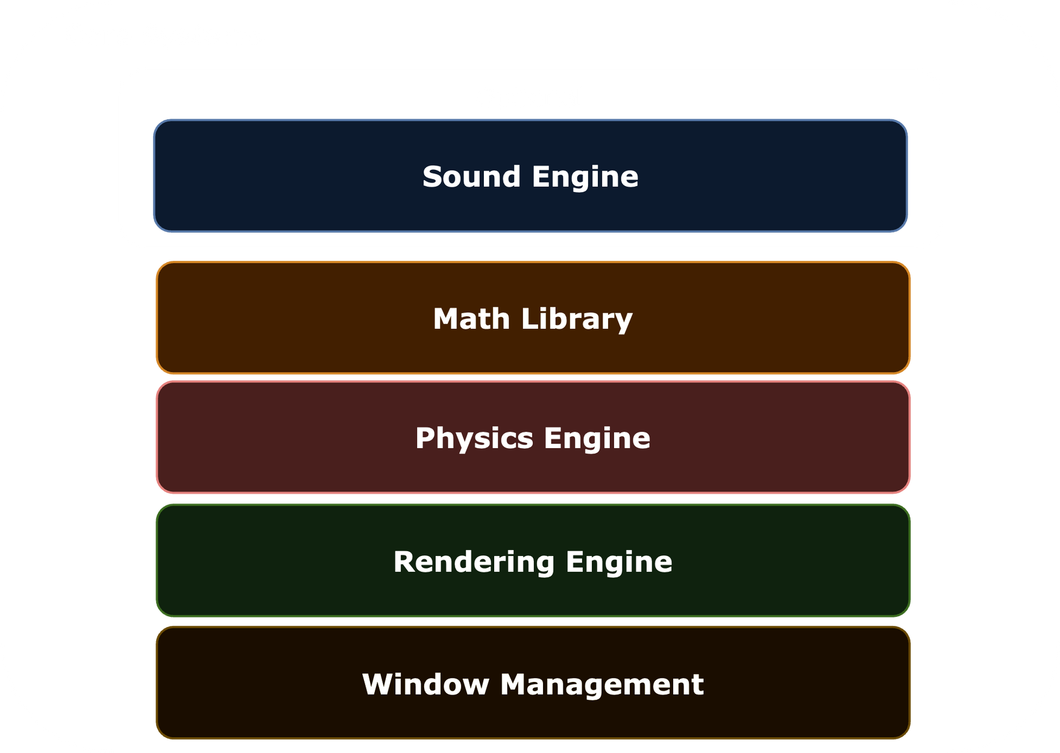
11

Slide 15
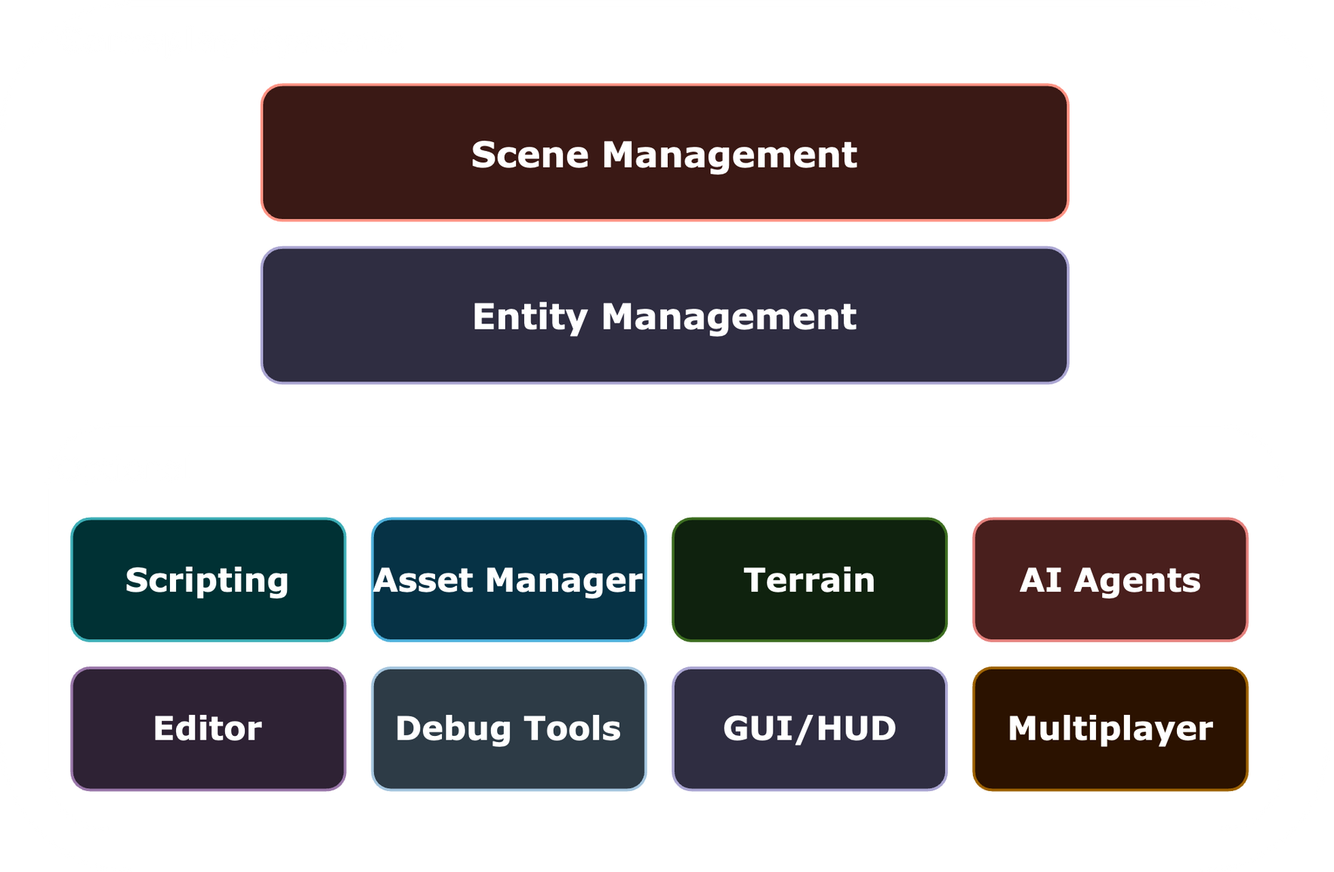
12

Slide 16
13
SIMPLICITY OF A GAME ENGINE

Slide 17
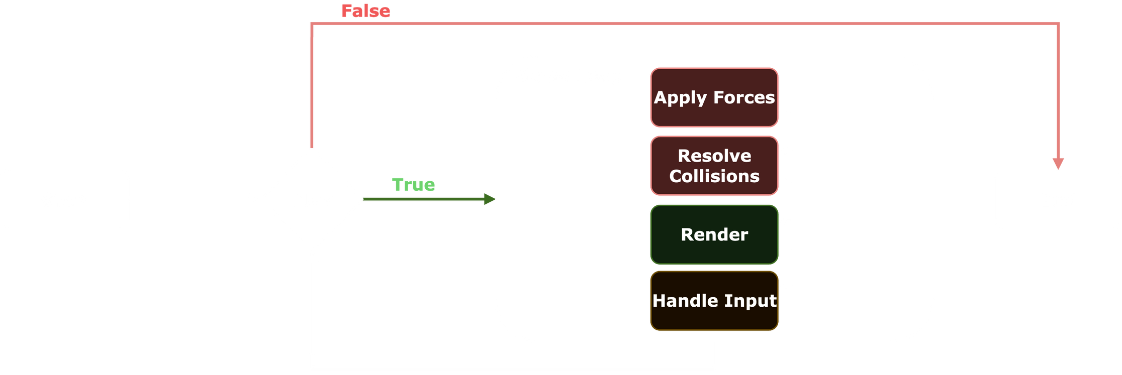
14
GAME LOOP
Notes:
Well let's start with a game - a game is just a loop, and in that loop your game logic happens, each “tick/frame” is a single iteration of that loop, during this loop you will handle input, move the player, draw to the screen, do collision checks etc
A game engine is just all your components combined into a game loop at the end of the day
Ok then how is making one simple?
It doesn't need to have a fancy GUI, level editor, scripting system, etc to be a game engine
A “game engine” can simply just be a few reusable classes, it doesn't need to be some monolithic program or sdk.
In Fact this is how a lot of early games in the 90s and 2000s were built.

Slide 18
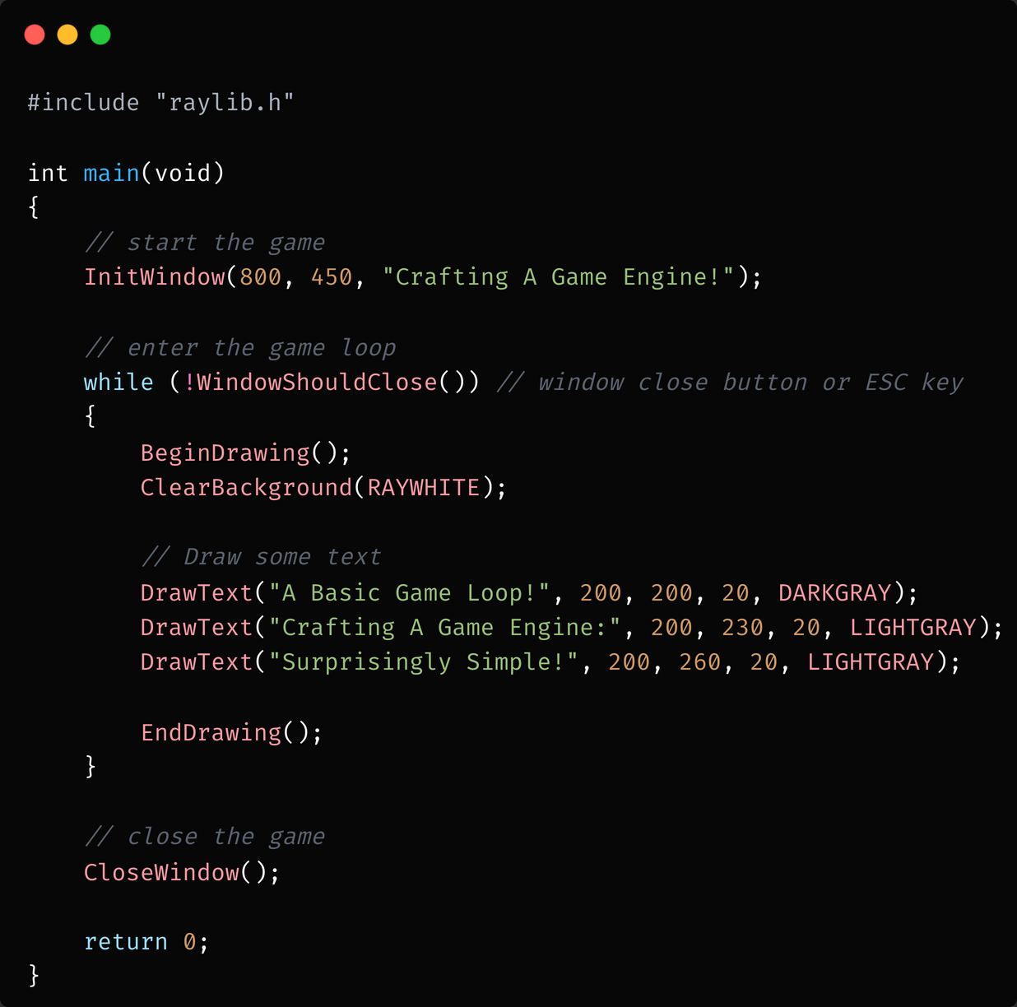
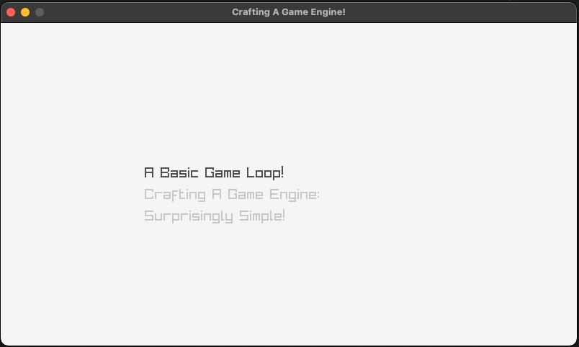
15
EXAMPLE
Notes:
Well let's start with a game - a game is just a loop, and in that loop your game logic happens, each “tick/frame” is a single iteration of that loop, during this loop you will handle input, move the player, draw to the screen, do collision checks etc
A game engine is just all your components combined into a game loop at the end of the day
Ok then how is making one simple?
It doesn't need to have a fancy GUI, level editor, scripting system, etc to be a game engine
A “game engine” can simply just be a few reusable classes, it doesn't need to be some monolithic program or sdk.
In Fact this is how a lot of early games in the 90s and 2000s were built.

Slide 19
16
LET’S BUILD A DEMO!

Slide 20
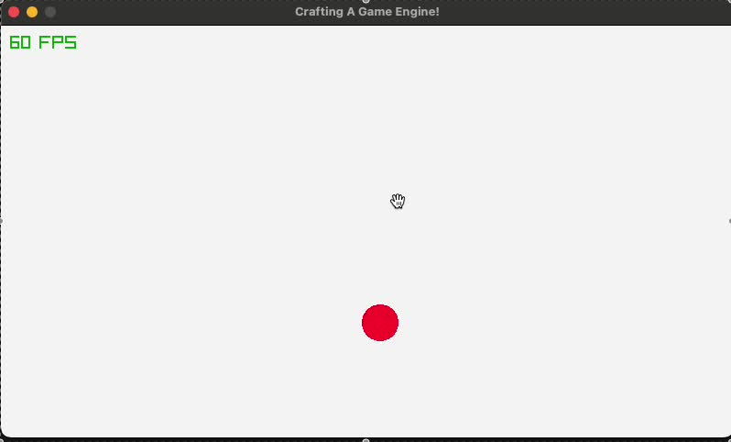
17
BOUNCING BALL
Notes:
Well let's start with a game - a game is just a loop, and in that loop your game logic happens, each “tick/frame” is a single iteration of that loop, during this loop you will handle input, move the player, draw to the screen, do collision checks etc
A game engine is just all your components combined into a game loop at the end of the day
Ok then how is making one simple?
It doesn't need to have a fancy GUI, level editor, scripting system, etc to be a game engine
A “game engine” can simply just be a few reusable classes, it doesn't need to be some monolithic program or sdk.
In Fact this is how a lot of early games in the 90s and 2000s were built.

Slide 21
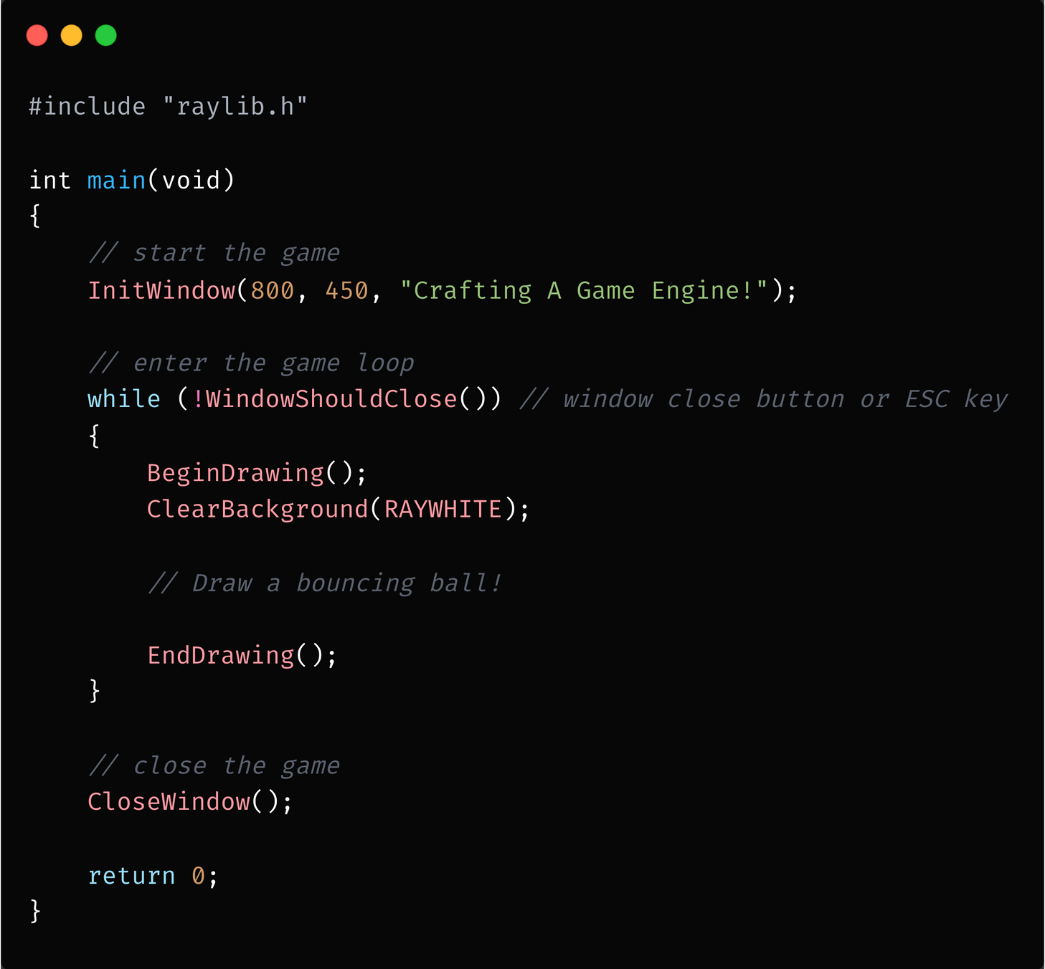
18
WHERE’S MY BALL?
Notes:
Well let's start with a game - a game is just a loop, and in that loop your game logic happens, each “tick/frame” is a single iteration of that loop, during this loop you will handle input, move the player, draw to the screen, do collision checks etc
A game engine is just all your components combined into a game loop at the end of the day
Ok then how is making one simple?
It doesn't need to have a fancy GUI, level editor, scripting system, etc to be a game engine
A “game engine” can simply just be a few reusable classes, it doesn't need to be some monolithic program or sdk.
In Fact this is how a lot of early games in the 90s and 2000s were built.

Slide 22
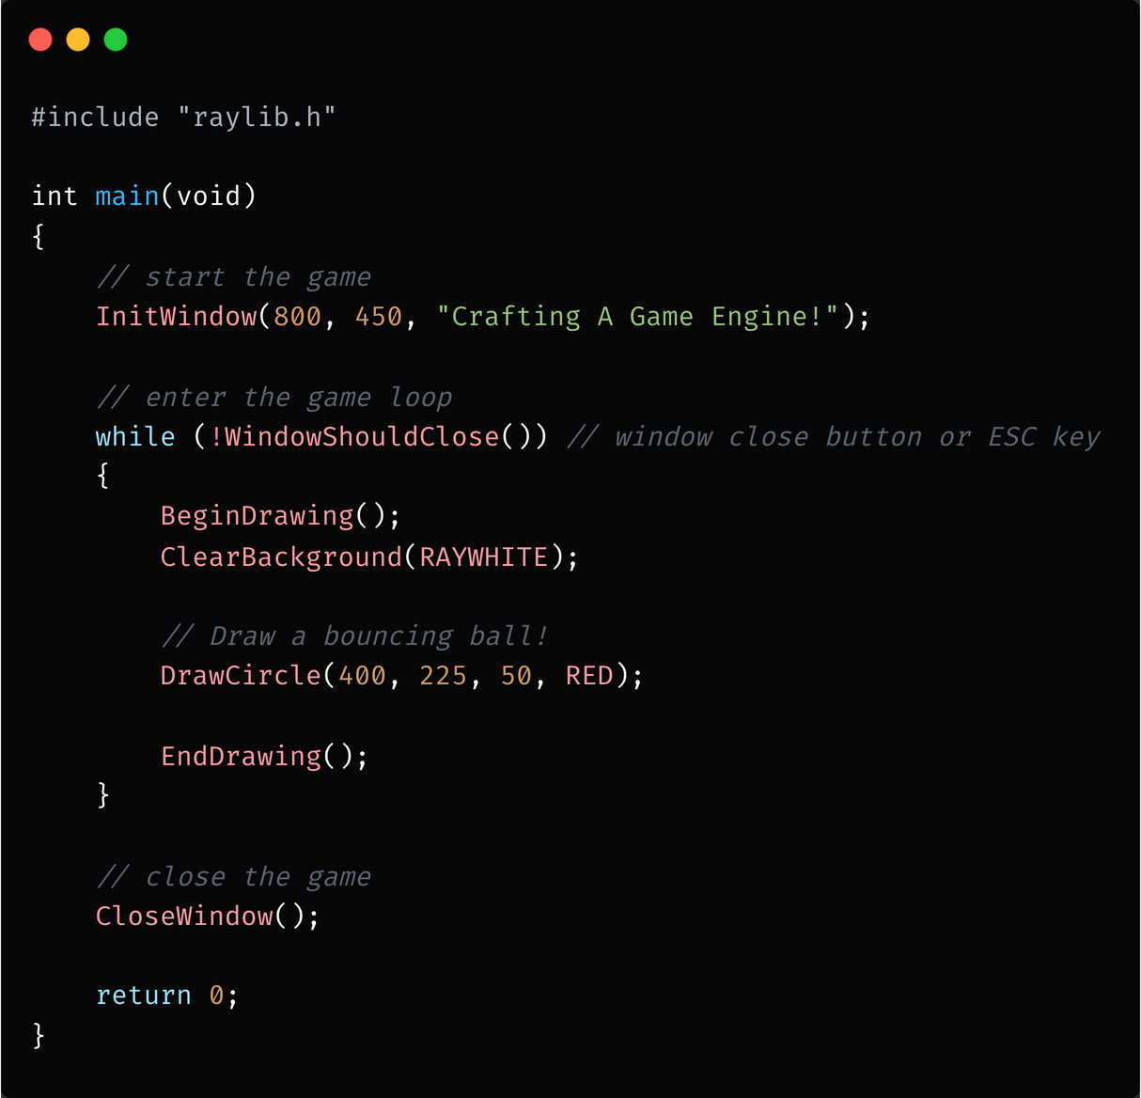
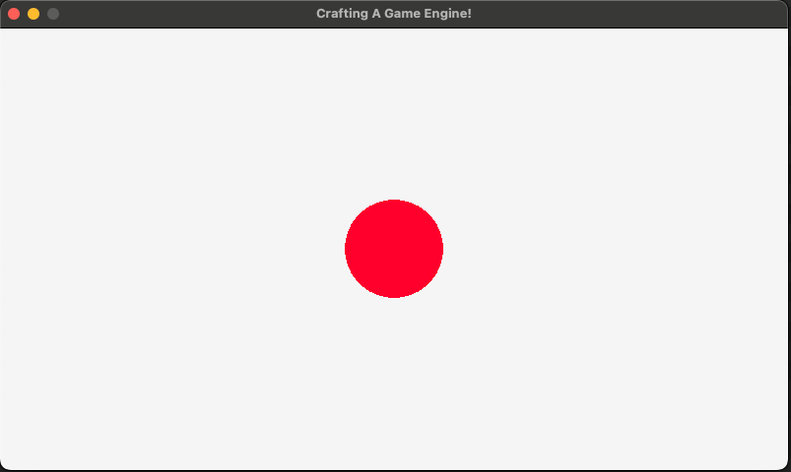
19
THERE’S MY BALL!
Notes:
Well let's start with a game - a game is just a loop, and in that loop your game logic happens, each “tick/frame” is a single iteration of that loop, during this loop you will handle input, move the player, draw to the screen, do collision checks etc
A game engine is just all your components combined into a game loop at the end of the day
Ok then how is making one simple?
It doesn't need to have a fancy GUI, level editor, scripting system, etc to be a game engine
A “game engine” can simply just be a few reusable classes, it doesn't need to be some monolithic program or sdk.
In Fact this is how a lot of early games in the 90s and 2000s were built.

Slide 23
20
BUT IT’S NOT BOUNCING?

Slide 24
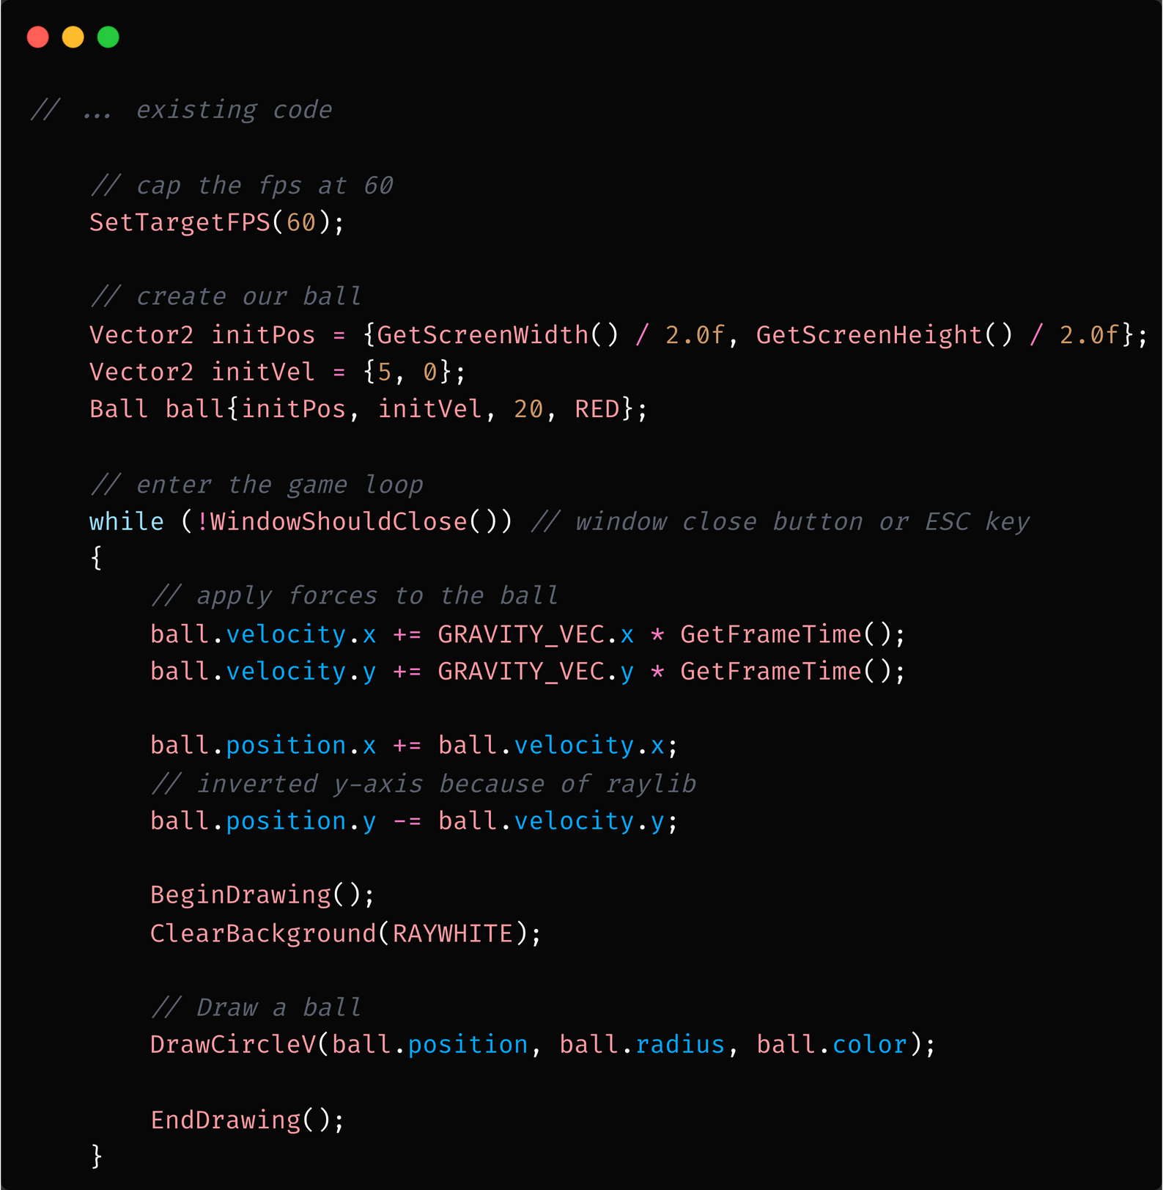
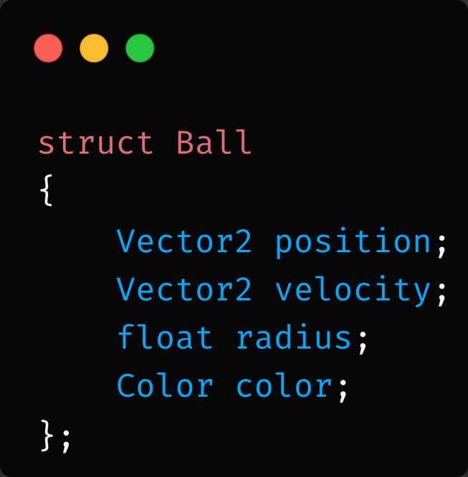
21
Notes:
Well let's start with a game - a game is just a loop, and in that loop your game logic happens, each “tick/frame” is a single iteration of that loop, during this loop you will handle input, move the player, draw to the screen, do collision checks etc
A game engine is just all your components combined into a game loop at the end of the day
Ok then how is making one simple?
It doesn't need to have a fancy GUI, level editor, scripting system, etc to be a game engine
A “game engine” can simply just be a few reusable classes, it doesn't need to be some monolithic program or sdk.
In Fact this is how a lot of early games in the 90s and 2000s were built.

Slide 25
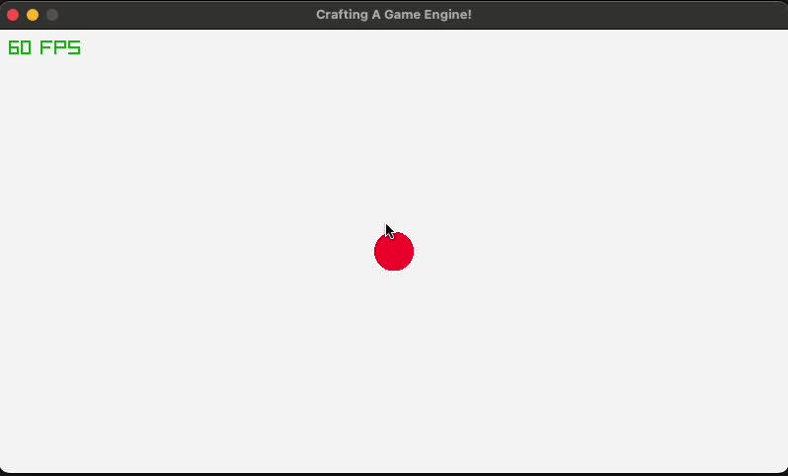
22
BOUNCING BALL
Notes:
Well let's start with a game - a game is just a loop, and in that loop your game logic happens, each “tick/frame” is a single iteration of that loop, during this loop you will handle input, move the player, draw to the screen, do collision checks etc
A game engine is just all your components combined into a game loop at the end of the day
Ok then how is making one simple?
It doesn't need to have a fancy GUI, level editor, scripting system, etc to be a game engine
A “game engine” can simply just be a few reusable classes, it doesn't need to be some monolithic program or sdk.
In Fact this is how a lot of early games in the 90s and 2000s were built.

Slide 26
23
IT’S STILL NOT BOUNCING!

Slide 27
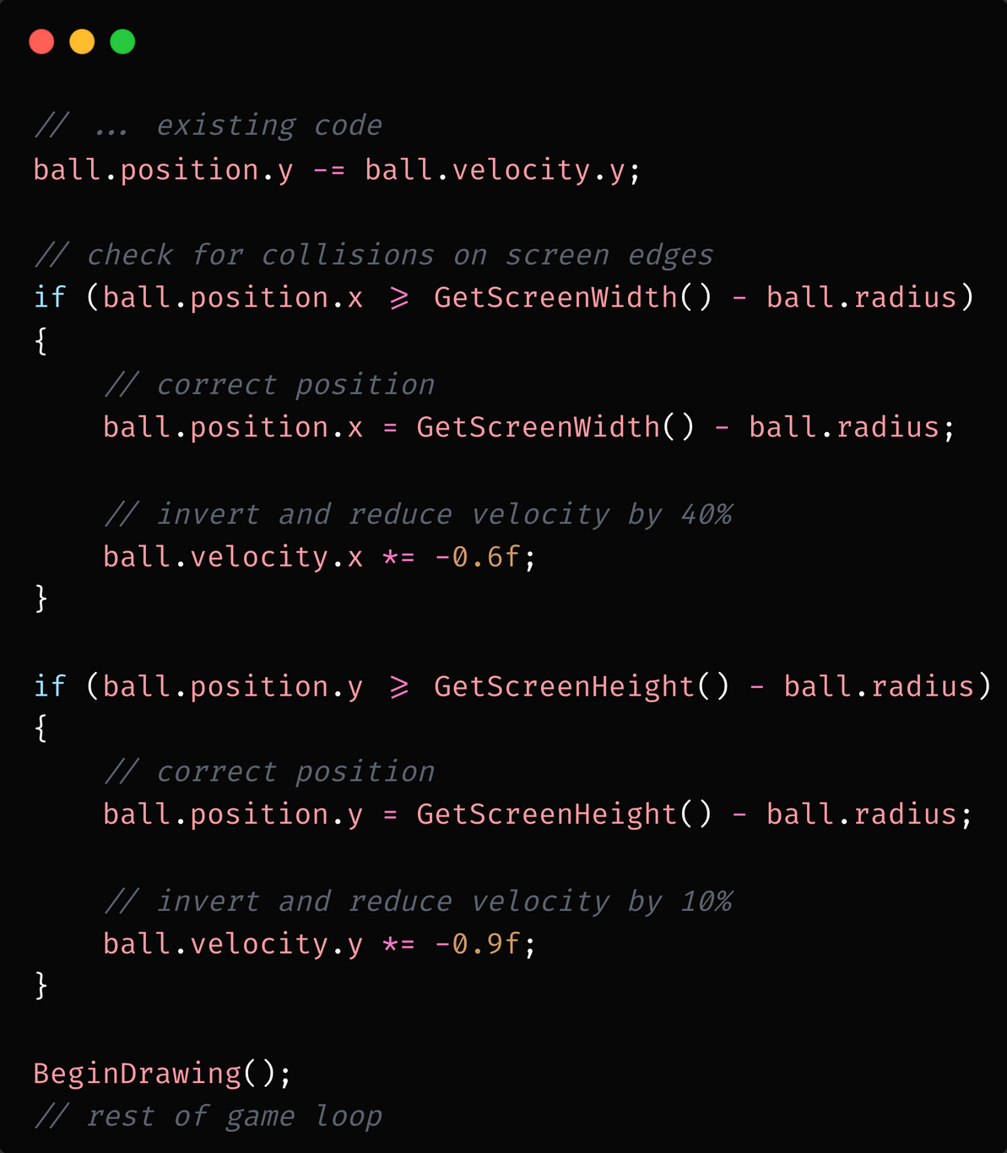
24
BOUNCING BALL
Notes:
Well let's start with a game - a game is just a loop, and in that loop your game logic happens, each “tick/frame” is a single iteration of that loop, during this loop you will handle input, move the player, draw to the screen, do collision checks etc
A game engine is just all your components combined into a game loop at the end of the day
Ok then how is making one simple?
It doesn't need to have a fancy GUI, level editor, scripting system, etc to be a game engine
A “game engine” can simply just be a few reusable classes, it doesn't need to be some monolithic program or sdk.
In Fact this is how a lot of early games in the 90s and 2000s were built.

Slide 28
25
BOUNCING BALL
Notes:
Well let's start with a game - a game is just a loop, and in that loop your game logic happens, each “tick/frame” is a single iteration of that loop, during this loop you will handle input, move the player, draw to the screen, do collision checks etc
A game engine is just all your components combined into a game loop at the end of the day
Ok then how is making one simple?
It doesn't need to have a fancy GUI, level editor, scripting system, etc to be a game engine
A “game engine” can simply just be a few reusable classes, it doesn't need to be some monolithic program or sdk.
In Fact this is how a lot of early games in the 90s and 2000s were built.

Slide 29
26
REFACTORING TIME

Slide 30
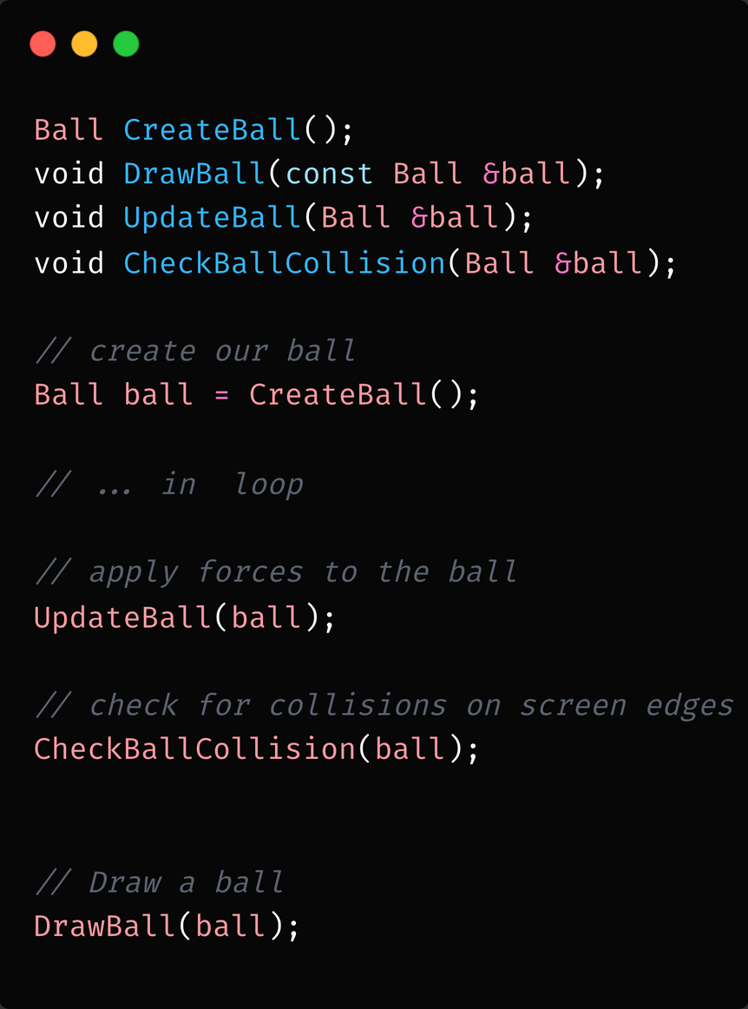
27
BOUNCING BALL
Notes:
Well let's start with a game - a game is just a loop, and in that loop your game logic happens, each “tick/frame” is a single iteration of that loop, during this loop you will handle input, move the player, draw to the screen, do collision checks etc
A game engine is just all your components combined into a game loop at the end of the day
Ok then how is making one simple?
It doesn't need to have a fancy GUI, level editor, scripting system, etc to be a game engine
A “game engine” can simply just be a few reusable classes, it doesn't need to be some monolithic program or sdk.
In Fact this is how a lot of early games in the 90s and 2000s were built.

Slide 31
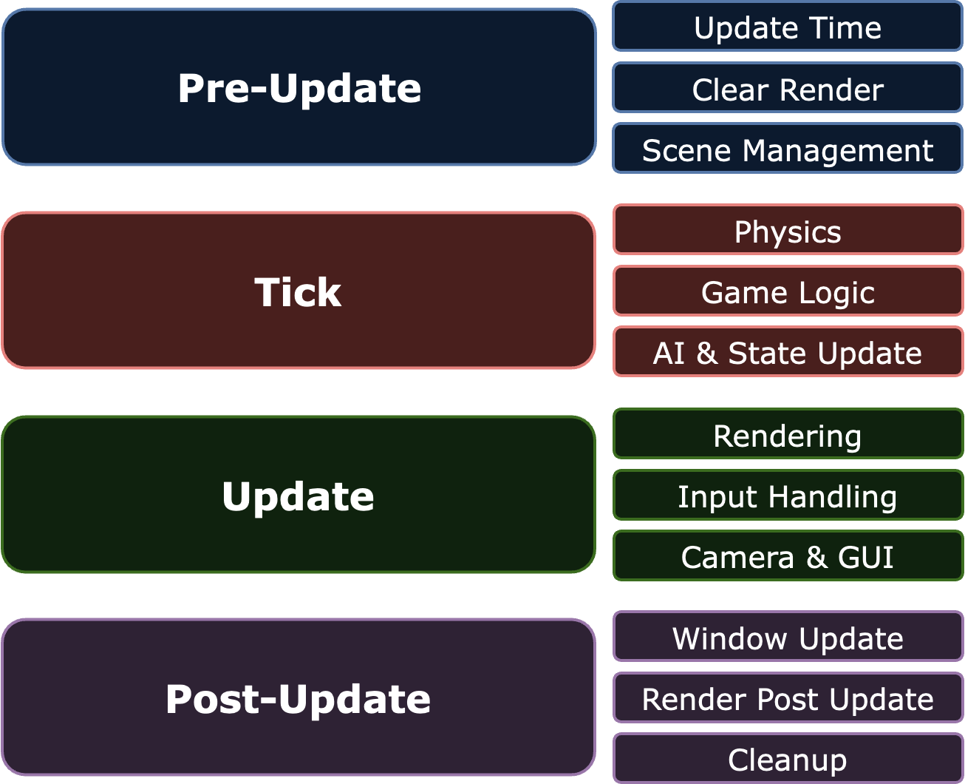
28
ENGINE SCHEDULES
PRE-INIT
Init
Post-Init
LOOP
Pre-Update
Tick
Update
Post-Update
Exit

Slide 32

29
OOP APPROACH

Slide 33

30
FP APPROACH

Slide 34
31
LET’S IMPLEMENT SCHEDULES!

Slide 35
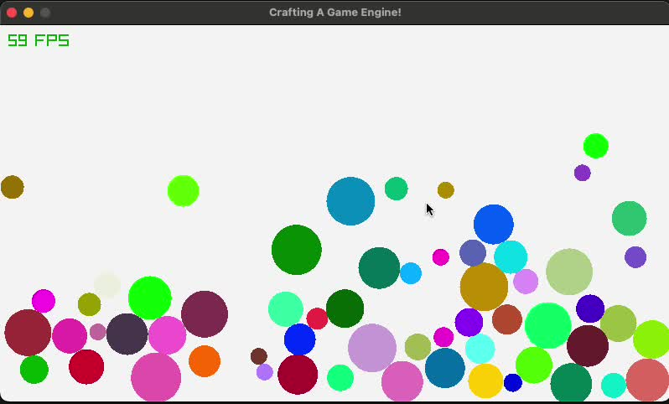
32
BOUNCING BALLS

Slide 36
33
ENTITY COMPONENT
SYSTEM
(ECS)

Slide 37
34
WHAT IS AN ECS?

Slide 38

35
ENTITY
ENTITIES ARE JUST ID’S

Slide 39

36
ENTITY LIST
ENTITY LIST IS JUST AN ARRAY OF IDS

Slide 40

37
COMPONENTS
DATA ORIENTED DESIGN
COMPONENTS ONLY STORE DATA

Slide 41
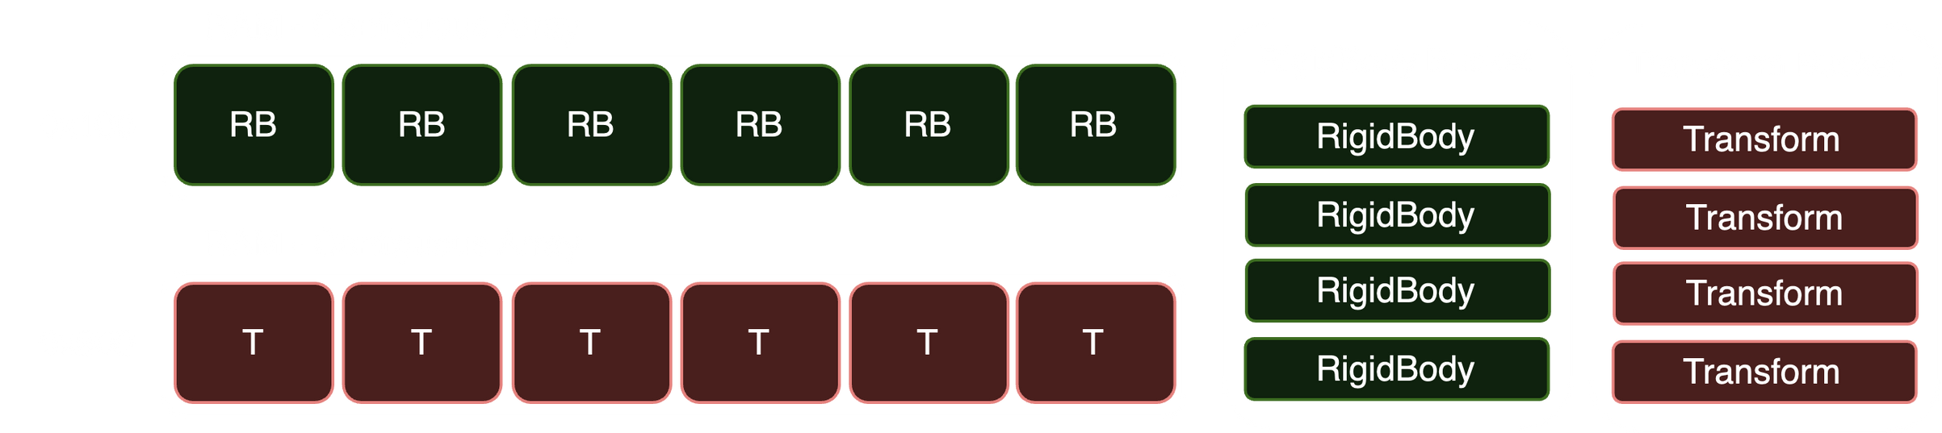
38
COMPONENTS
COMPONENTS IN CONTIGUOUS ARRAYS
DESIGNED TO REDUCE CPU CACHE MISSES

Slide 42
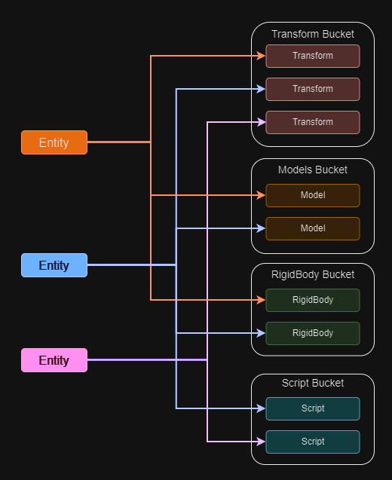
39
COMPONENTS

Slide 43
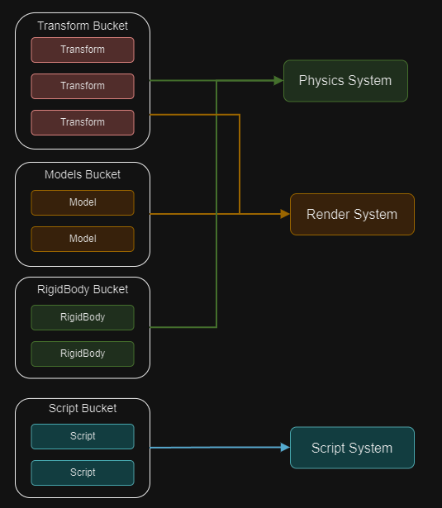
40
SYSTEMS

Slide 44
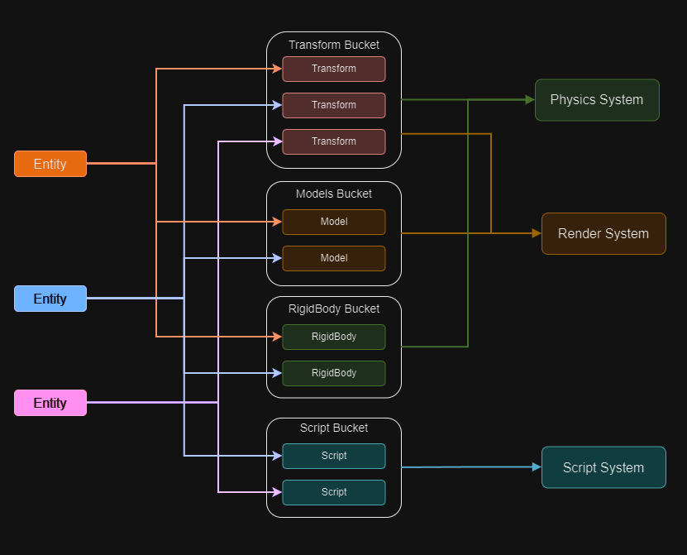
41

Slide 45
42
BUILDING A MONOLITHIC GAME ENGINE:
WHAT IT TAKES

Slide 46
43
CORE SYSTEMS

Slide 47
44
GAMEPLAY SYSTEMS

Slide 48
45
FACADE PATTERN

Slide 49
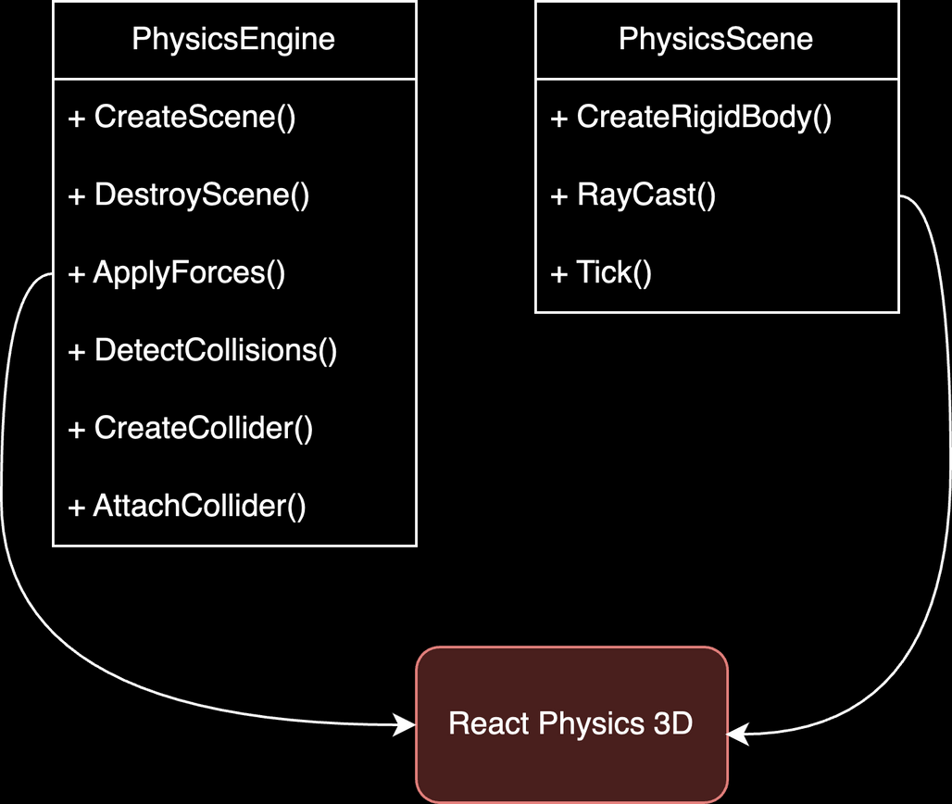
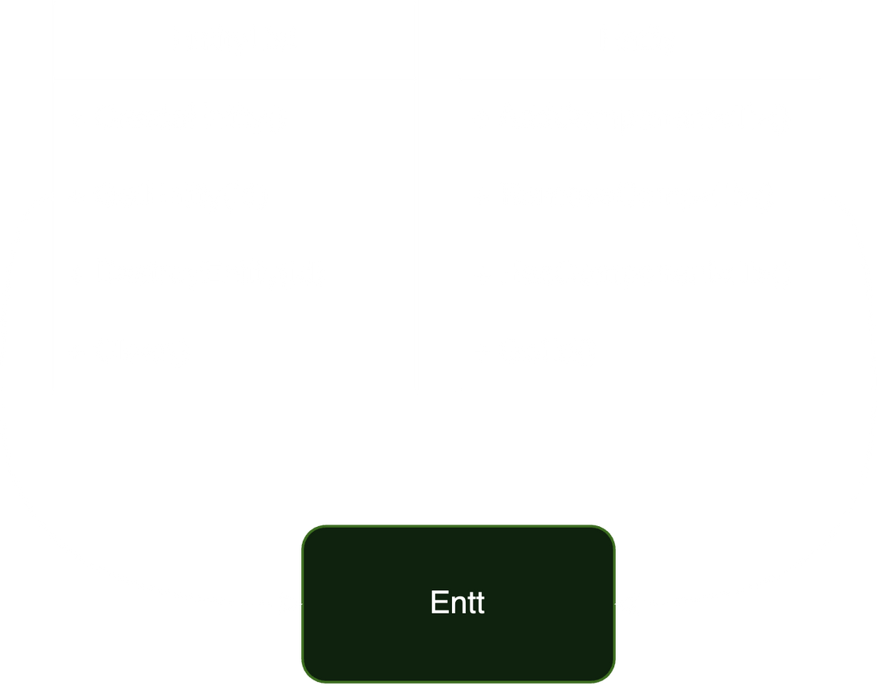
46
FACADE

Slide 50





47
WINDOW MANAGER

Slide 51




48
GRAPHICS ENGINE

Slide 52


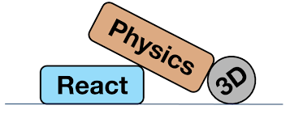

49
PHYSICS ENGINE
JOLT PHYSICS

Slide 53


50
ENTITY MANAGEMENT

Slide 54
51
PRACTICAL TIPS FOR GETTING STARTED

Slide 55





52
GETTING STARTED
Start small & iterate
Modular Design
Scope Creep
Leverage Libraries
Read & Learn
Dive into engines

Slide 56

53
Have Fun!

Slide 57
54
COMMON PITFALLS AND HOW TO AVOID THEM

Slide 58

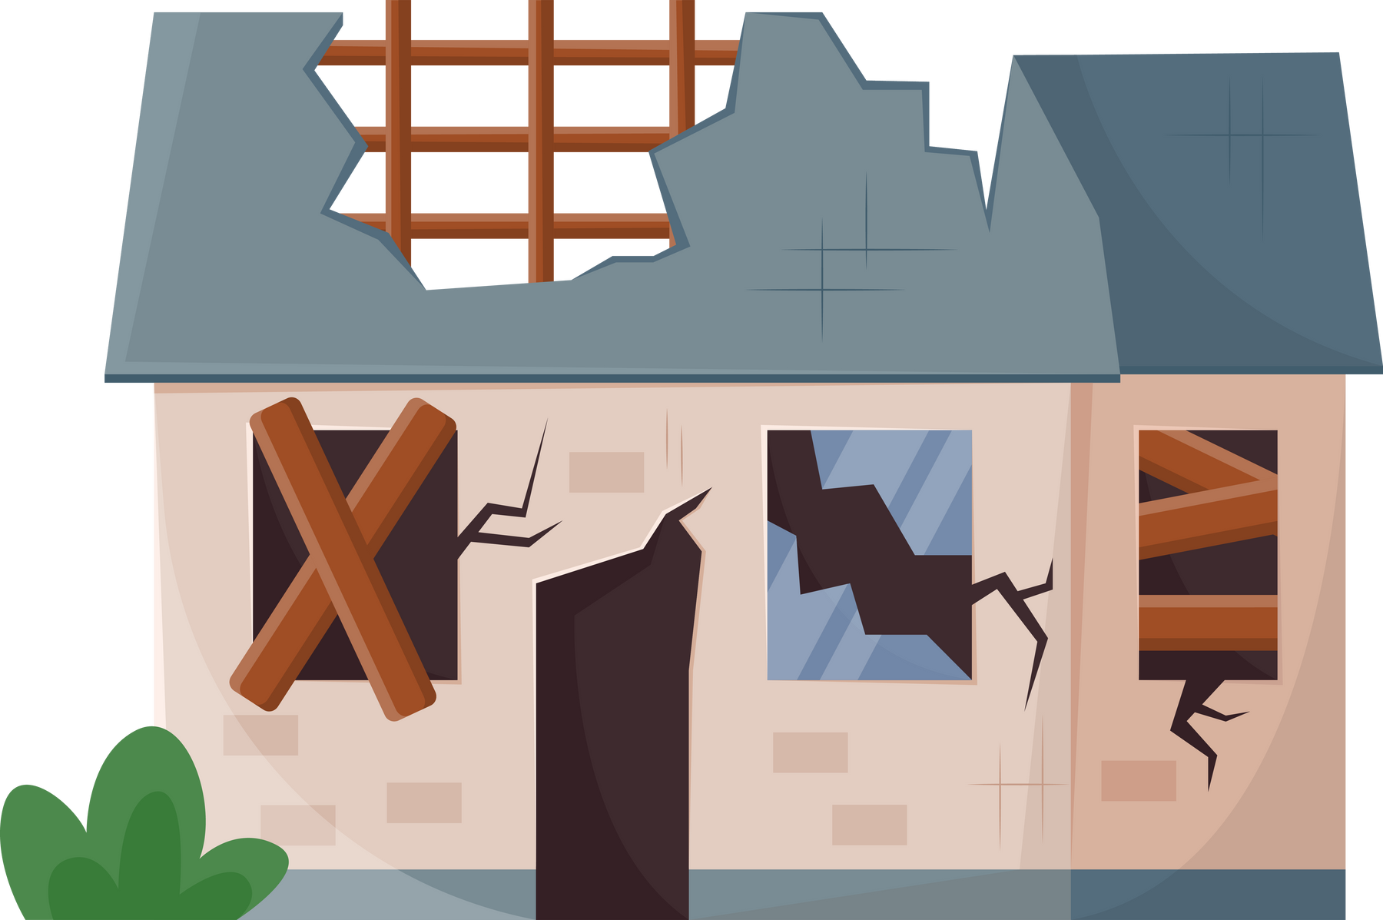

55
PITFALLS
OVER ENGINEERING
POOR ARCHITECTURE
TIGHT COUPLING

Slide 59
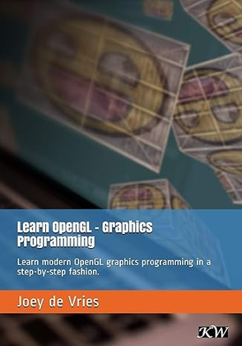
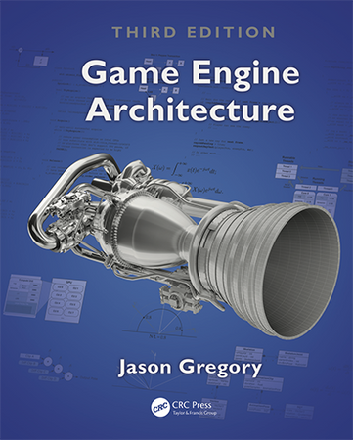
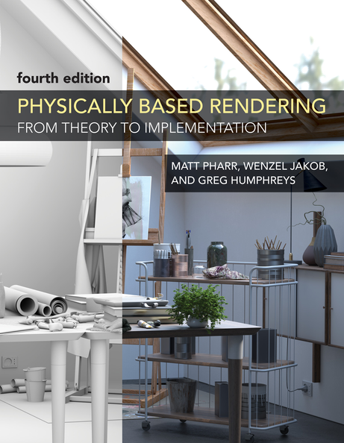


56
RESOURCES
LEARNOPENGL
GAME ENGINE ARCHITECTURE
GAME PHYSICS COOKBOOK
PHYSICALLY BASED RENDERING BOOK
AAA STUDIO RESEARCH PAPERS
YOUTUBE!

Slide 60
QUESTIONS

Slide 61

THANK YOU
DEMO CODE
GITHUB
GIT REPO

